Slide 1



AI & Cognition PROJECT
A KNOWLEDGE BASED
RECOMMENDATION SYSTEM
Realized by :
LAKHAL Abir
HMAIDI Mehdi
BELAIDI Nada
MAGHREBI Racha
CHARAABI Khaled
KHECHANA Fares
Supervised by:
ZOUAGA Wiem
University Year : 2021 - 2022
recommender system
Introduction
our approch
Summary
conclusion
Data comprehension
Notes:
Abir

Slide 2
Introduction
Our Approach
Conclusion
our approach
1
3
5
Summary
recommender system
Introduction
conclusion
Problématisolution
4
2
Data Comprehension
Recommender
System

Slide 3
INTRODUCTION

Slide 4
Project Description :
A fundamental aspect of successfully managing projects is to have both the right understanding and the right tools to efficiently manage risks which are inherent in every project.
we have developed our Project Risk Management software application, which is designed to be as intuitive as possible, guiding users to accurately identify, quantify and mitigate all risks on their projects.
Notes:
A fundamental aspect of successfully managing projects is to have both the right understanding and the right tools to efficiently manage risks which are inherent in every project.
To help achieve this, we have developed our Project Risk Management software application, which is designed to be as intuitive as possible, guiding users to accurately identify, quantify and mitigate all risks on their projects.

Slide 5



Study of the existing
Summary
recommender system
Data comprehension
conclusion
our approach
Introduction
Notes:
abir

Slide 6
Criticism of the existing
Lack of security.
Basic and general sites.
No updates.
Summary
recommender system
Data comprehension
Introduction
conclusion
our approach

Slide 7
Solution
Implementation of an updated and securised application based on a recommendation system,
for Project Risk Management.
Summary
recommender system
conclusion
Data comprehension
our approach
Introduction

Slide 8
DATA COMPREHENSION

Slide 9


OUR DATA
recommender system
conclusion
our approach
DATA COMPREHENSION
Summary
Conclusion
PMBOK 5th :
A Guide to the Project Management Body of Knowledge
PMI
Practice Standard for Project Risk Management
Notes:
feres

Slide 10
The PMBOK 5th Guide :
Provides guidelines for managing individual projects and defines project management related concepts.
Contains the globally recognized standard and guide for the project management profession.
recommender system
conclusion
our approach
Introduction
DATA COMPREHENSION
Summary
The PMI Practice Standard for Project Risk Management :
Describes processes, activities, inputs, and outputs for a specific Knowledge Area.
Provides a standard for project management practitioners and other stakeholders that defines the aspects of Project Risk Management that are recognized as good practice.
Notes:
feres

Slide 11
The processes
Plan Risk Management
Identify Risks
recommender system
Perform Qualitative Risk Analysis
conclusion
Introduction
our approach
DATA COMPREHENSION
Summary
Perform Quantitative Risk Analysis
Plan Risk Responses
Control Risks
Notes:
feres

Slide 12
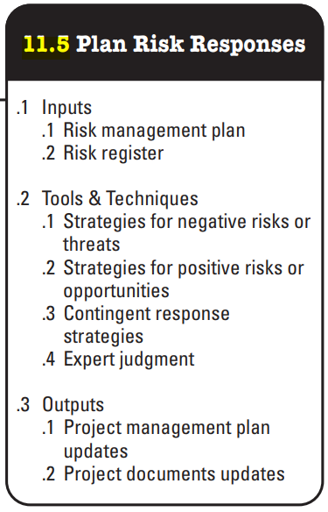
Each process has :
“Inputs”
“Outputs”
“Tools and Techniques”.
recommender system
conclusion
Introduction
our approach
DATA COMPREHENSION
Summary
Notes:
racha

Slide 13
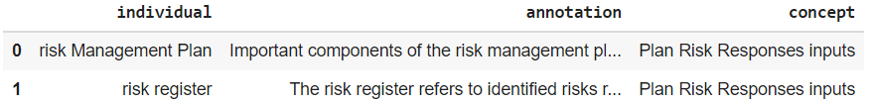
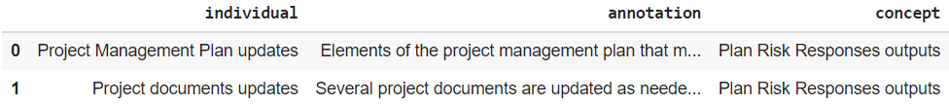
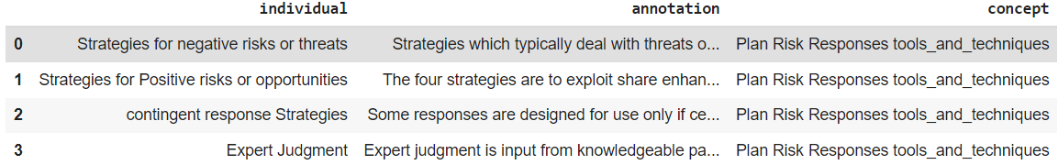
Example : Plan Risk Responses (5th process)
Inputs Dataframe
recommender system
conclusion
Introduction
Outputs Dataframe
DATA COMPREHENSION
Summary
Rec. System
Tools and Techniques Dataframe
Notes:
RACHA

Slide 14
Our
Approach

Slide 15
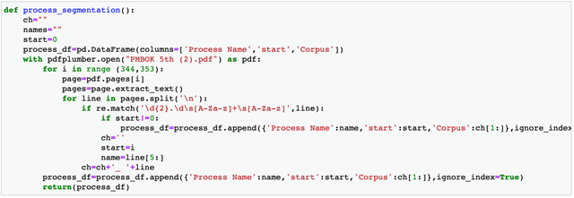
Data extraction and analysis
1.Text segmentation :
Data comprehension
Summary
conclusion
our approach
our approach
Etude et critique
Notes:
Abir:We start by segmenting our text data. It is a precursor to text retrieval, automatic summarization, information retrieval ; language modeling and natural language processing .

Slide 16
Data extraction and analysis
2.Text-preprocessing:
Since we have textual PDF data , we are in need of specific processing to be able to extract meanings and learn from this data in order to make it more useful. Thus, we proceeded by using the Natural Language Processing which is known as NLP.
our approach
Data comprehension
Summary
conclusion
our approach
Etude et critique
Notes:
abir

Slide 17
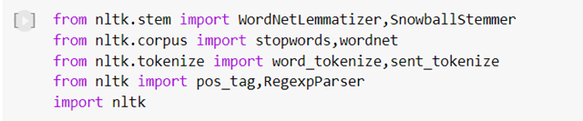
Data extraction and analysis
2.1 Libraries importing:
Summary
our approach
Data comprehension
conclusion
introduction
our approach
Notes:
khaled We imported the nltk library, which is a software library in Python allowing automatic language processing, so we can use WordNetLemmatizer, StopWords, word_tokenize, pos_tag..

Slide 18
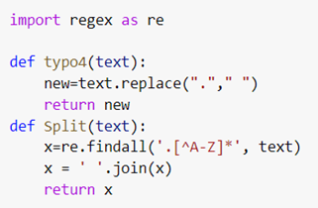
Data extraction and analysis
2.2 Regex :
Data comprehension
Summary
conclusion
our approach
introduction
ou approach
Notes:
khaledWe used the regular expression function to extract only the alphabetic expressions from the text (Remove all the other characters).

Slide 19
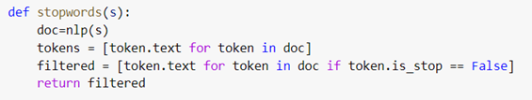
Data extraction and analysis
2.3 StopWords :
Data comprehension
Summary
conclusion
our approach
Etude et critique
spécification
Notes:
khaledMany words have little semantic interest, this is the reason for which the stop words must be deleted. Indeed, stopwords are all the most common words in a language. NLTK library has a list of stopwords for many languages and also tried removing stopwords using their POS in the sentence.

Slide 20

Data extraction and analysis
2.4 Remove Header :
Data comprehension
Summary
conclusion
our approach
introduction
spécification
Notes:
khaled

Slide 21

Data extraction and analysis
2.5 Postag :
Data comprehension
Summary
conclusion
our approach
introduction
our approach
Notes:
khaled It may not be possible to manually provide the correct POS tag for every word for large texts. So, instead, we will find out the correct POS tag for each word and map it.

Slide 22
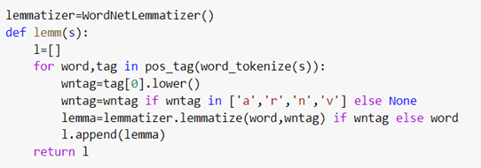
Data extraction and analysis
2.6 Lemmatization :
Data comprehension
Summary
conclusion
our approach
Etude et critique
spécification
Notes:
rachaThis processing consists in applying to the occurrences of lexemes subject to inflection a coding referring to their common lexical entry, which is designated under the term of lemma.

Slide 23
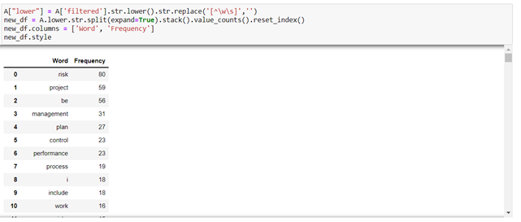
Data extraction and analysis
2.7 TF_IDF:
Data comprehension
Summary
conclusion
our approach
Etude et critique
spécification
Notes:
racha The TF-IDF is a weighting method often used in information retrieval and in particular in text mining. This statistical measure makes it possible to evaluate the importance of a term contained in a document, relative to a collection or a corpus.

Slide 24
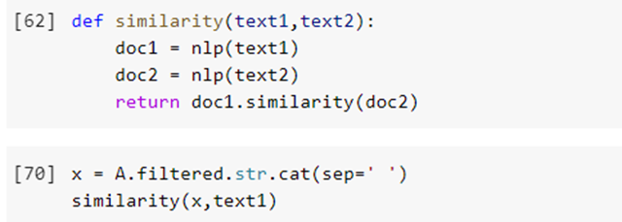
Data extraction and analysis
2.8 Similarity :
Data comprehension
Summary
conclusion
our approach
Etude et critique
spécification
Notes:
racha Text Similarity is one of the essential techniques of NLP which is being used to find the closeness between two chunks of text by it's meaning or by surfaces.
We used it in order to find out whether the text we started off with changed it’s meaning or not.
Our similarity rate was equal to 0.95.

Slide 25
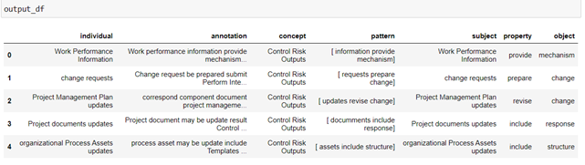
Data extraction and analysis
2.9 Triplet extraction :
Data comprehension
Summary
conclusion
our approach
Etude et critique
spécification
Notes:
abir Triples are a way to represent information from a text sentence in fewer words without losing the context. There are different techniques for getting this information before you represent it as triples, and the techniques depend on the kind of data being read as input.

Slide 26
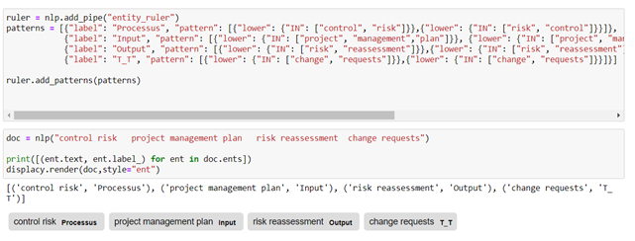
Data extraction and analysis
2.10 Rule based Matching :
Data comprehension
Summary
conclusion
our approach
Etude et critique
spécification
Notes:
abir Compared to using regular expressions on raw text, spaCy’s rule-based matcher engines and components not only let you find the words and phrases you’re looking for – they also give you access to the tokens within the document and their relationships.

Slide 27
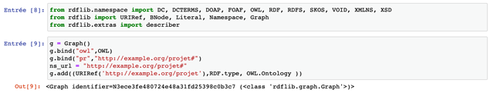
Ontology
1.OWL component building process
Data comprehension
Summary
conclusion
our approach
Etude et critique
spécification
Notes:
Using RDFLIB, we convert our obtained dataframes from the pre-processing process into OWL format. Then we add the properties and the classes into triples format while keeping the relationships between them. Beside we add prefixes to entities in order to differentiate between them

Slide 28
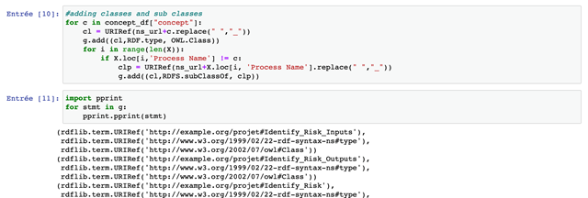
Ontology
2. Add classes and sub-classes :
Data comprehension
Summary
conclusion
our approach
Etude et critique
spécification
Notes:
The ontology class attribute can be used to associate your class to the given one.
We use the top-down approach to develop the classes and subclasses hierachy . we start with creating classes for the general concepts, our six processes Then we specialize each one by its inputs,outputs and tools.

Slide 29
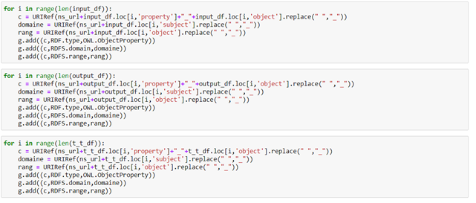
Ontology
3.add data proporties :
Data comprehension
Summary
our approach
Etude et critique
diagramme
spécification
Notes:
the classes alone will not provide enough information to build our ontology. Once we have defined the classes, we must describe the internal structure of concepts.in this case we have to add data proporties for each concept

Slide 30
4.1.Add object properties :
Ontology
Data comprehension
Summary
conclusion
our approach
Etude et critique
spécification
Notes:
Object properties connect two individuals a subject and object with a predicate, while with data properties the predicate connects a single subject with some form of attribute data.

Slide 31
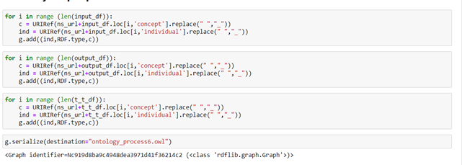
4.2.Add individuals:
Ontology
Data comprehension
Summary
conclusion
our approach
Etude et critique
spécification
Notes:
Object properties connect two individuals a subject and object with a predicate, while with data properties the predicate connects a single subject with some form of attribute data.

Slide 32
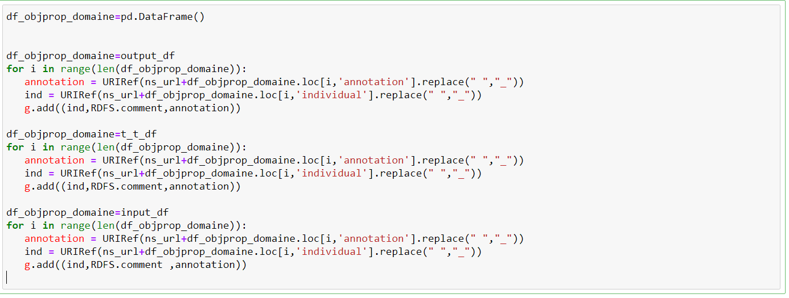
4.3.Add Annotation:
Ontology
Data comprehension
Summary
conclusion
our approach
Etude et critique
spécification
Notes:
Object properties connect two individuals a subject and object with a predicate, while with data properties the predicate connects a single subject with some form of attribute data.

Slide 33
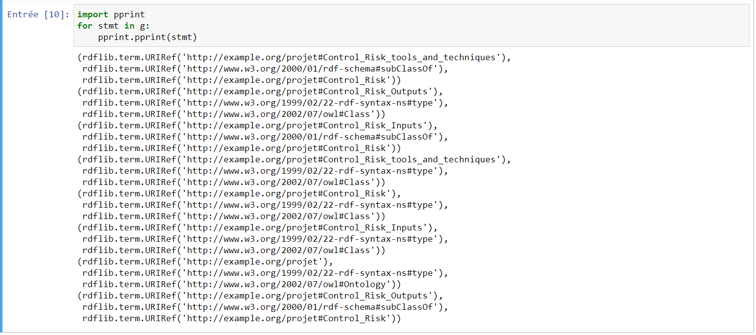
5.Visualisation of our ontology tree of process 6 with RDFLIB:
Ontology
Data comprehension
Summary
conclusion
our approach
Etude et critique
spécification
Notes:
Object properties connect two individuals a subject and object with a predicate, while with data properties the predicate connects a single subject with some form of attribute data.

Slide 34
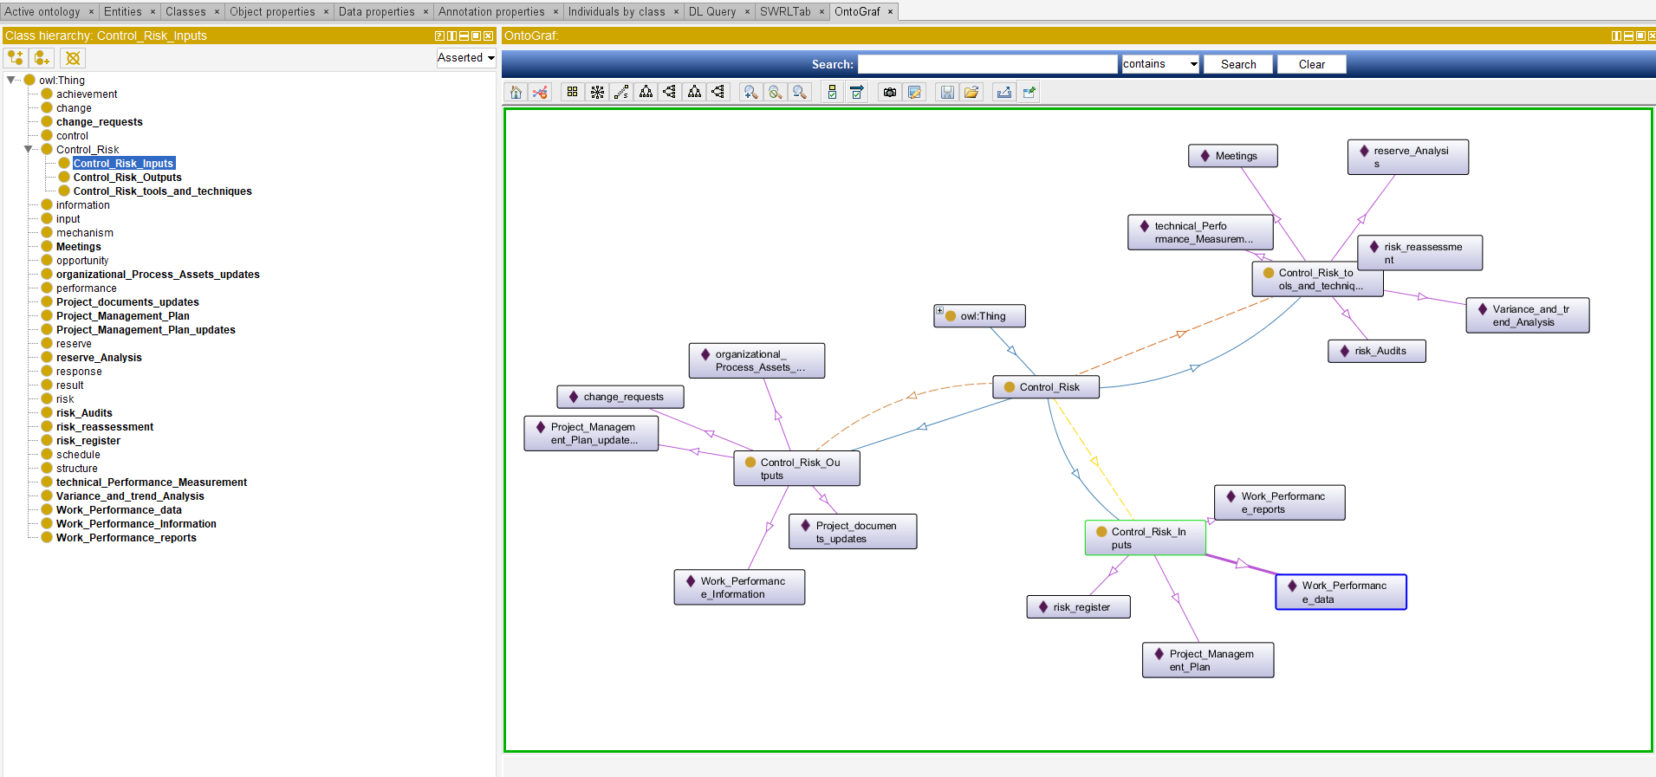
6.Visualisation of ontology of process 6 with protege:
Ontology
Data comprehension
Summary
conclusion
our approach
Etude et critique
spécification

Slide 35
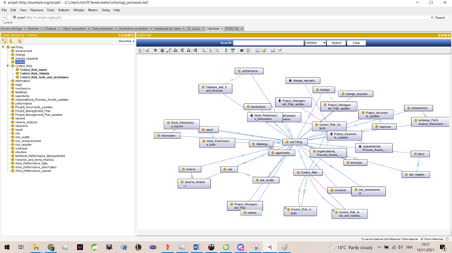
Ontology
Data comprehension
Summary
conclusion
our approach
Etude et critique
spécification

Slide 36
Recommender System
Notes:
Pour conclure, on peut dire que le projet est faisable , rentable et très interessant
Ainsi nous terminons avec une citation d’Aristote : « Le plaisir dans le métier met la perfection dans le travail ».

Slide 37
Recommender system
Creation of the model based on TF-IDF :
Data comprehension
Summary
conclusion
our approach
Etude et critique
We used TF-IDF to create our model to compare query with our ontology classes.
spécification
Notes:
In this step, we will explain how we deployed our recommender system

Slide 38
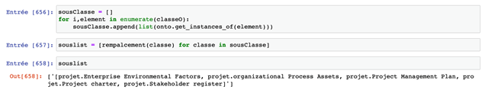
Recommender system
Here’s an example of similarity between our query and the ontology class with an accurancy higher then 70%
Data comprehension
Summary
conclusion
our approach
Etude et critique
spécification
Notes:
Here’s an example of similarity between our query and the ontology class with an accurancy higher then 70%

Slide 39
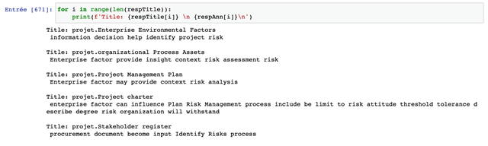
Recommender system
This is an example of an output of our reccomender system
Data comprehension
Summary
conclusion
our approach
Etude et critique
spécification
Notes:
Here’s an example of similarity between our query and the ontology class with an accurancy higher then 70%

Slide 40
Conclusion &
Perspectives
Notes:
Feres Finding the best project risk management application can be a challenge at the beginning. But with "Risk free" the ideal app that provides flexibility and a wide range of risk assessment features we provide practicing risk control and risk elimination at any level of your business structure.

